Slide 1
Introduction to the Malnutrition Quality Improvement Initiative (MQii)
1

Slide 2
Overview
The Case for Malnutrition Quality Improvement
Background on the Malnutrition Quality Improvement Initiative (MQii)
The MQii Learning Collaborative: Toolkit and eCQM Testing and Implementation
2

Slide 3
The Case for Malnutrition Quality Improvement
3

Slide 4
Malnutrition Is a Highly Prevalent Condition
Affects 20-50% of patients, who are at risk of becoming or are malnourished upon hospital admission^{1,2}
Is typically diagnosed in only 7% of hospitalized patients, leaving many potentially undiagnosed and untreated³
Up to 31% of malnourished patients and 38% of well-nourished patients experience nutritional decline during their hospital stay⁴
Barker LA, Gout BS, and Crowe TC. Hospital malnutrition: prevalence, identification, and impact on patients and the healthcare system. Int J Environ Res and Public Health. 2011;8:514-527.
Pereira GF, Bulik CM, Weaver MA, Holland WC, Platts-mills TF. Malnutrition among cognitively intact, noncritically ill older adults in the emergency department. Ann Emerg Med. 2015;65(1):85-91.
Weiss AJ, Fingar KR, Barrett ML, Elixhauser A, Steiner CA , Guenter P, Brown MH. Characteristics of hospital stays involving malnutrition, 2013. HCUP Statistical Brief #210. September 2016. Agency for Healthcare Research and Quality, Rockville, MD. http://www.hcup-us.ahrq.gov/reports/statbriefs/sb210-Malnutrition-Hospital-Stays- 2013.pdf.
Braunschweig C et al. Impact of declines in nutritional status on outcomes in adult patients hospitalized for more than 7 days. J Am Diet Assoc 2000; 100 (11): 1316- 1322.
4

Slide 5
Malnutrition Poses a Significant Burden to Patients and Hospitals
Associated with an
up to 5x higher likelihood
of in-hospital death compared
to non-malnourished patients¹
Creates greater risk of hospital- acquired infections, falls, pressure ulcers, and slower wound healing²
Associated with a
54% higher likelihood of
30-day readmissions, with septicemia as the leading diagnosis upon readmission³
More than doubles
average hospital costs per stay,¹
with readmissions costing
26-34% higher than those
for patients without malnutrition³
Weiss AJ, Fingar KR, Barrett ML, Elixhauser A, Steiner CA , Guenter P, Brown MH. Characteristics of hospital stays involving malnutrition, 2013. HCUP Statistical Brief #210. September 2016. Agency for Healthcare Research and Quality, Rockville, MD. http://www.hcup-us.ahrq.gov/reports/statbriefs/sb210-Malnutrition-Hospital-Stays- 2013.pdf.
Isabel M and Correia TD. The impact of malnutrition on morbidity, mortality, length of hospital stay and costs evaluated through a multivariate model analysis. Cli Nutr. 2003;22(3):235–239.
Fingar KR, et al. Statistical Brief #281: All-cause readmissions following hospital stays for patients with malnutrition, 2013. Agency for Healthcare Research and Quality,
Healthcare Cost and Utilization Project. September 2016.
5

Slide 6
Malnutrition Contributes to High Healthcare Costs
$157 Billion
Morbidity, mortality, and direct medical costs associated with disease-related malnutrition
$51.3 Billion
Annual costs of disease-associated malnutrition attributable to older adult patients
1. Snider JT, Linthicum MT, Wu Y, et al. Economic burden of community-based disease-associated malnutrition in the United States. JPEN J Parenter Enteral Nutr. 2014;38(2 Suppl):77S-85S.
6

Slide 7
Addressing Malnutrition Can Improve Patient Outcomes and Lower Costs
RECENT STUDIES DEMONSTRATE THAT PROVIDING OPTIMAL MALNUTRITION CARE IS ASSOCIATED WITH IMPROVED OUTCOMES
Optimizing malnutrition care in an Accountable Care Organization (ACO) with multiple hospitals reduced readmission rates by 27%¹
Supporting early nutritional care can reduce pressure ulcer incidence, length of stay, 30-day readmissions, and costs of care²
Implementation of a nutrition-focused quality improvement program resulted in over $4.8M in cost savings across four hospitals³
Sriram K, Sulo S, VanDerBosch G, et al. A comprehensive nutrition-focused quality improvement program reduces 30-day readmissions and length of stay in hospitalized patients. JPEN J Parenter Enteral Nutr. 2017;41(3):384-391.
Meehan A, Loose C, Bell J, Partridge J, Nelson J, Goates S. health system quality improvement: impact of prompt nutrition care on patient outcomes and health care costs. J Nurs Care Qual. 2016;31(3):217-23.
3. Sulo S, Feldstein J, Partridge J, et al. Budget impact of a comprehensive nutrition-focused quality improvement program for malnourished hospitalized patients. Am Health Drug Benefits. 2017;10(5):262-270.
7

Slide 8
Quality Malnutrition Care Can Help Hospitals Achieve National Quality Requirements
Optimal malnutrition care reduces adverse patient outcomes for which hospitals increasingly face penalties from the Centers for Medicare & Medicaid Services (CMS):
Hospital Readmissions Reduction Program: 3% penalty
Hospital-Acquired Conditions Reduction Program:
1% penalty
Hospital Inpatient Quality Reporting Program:
1/4 reduction to market basket update
Hospital Outpatient Reporting Program: 1/4 reduction to market basket update
Hospital Value-Based Purchasing Program: 2% penalty
Private payers have established similar efforts to incentivize better
care and outcomes.

Slide 9
Background on the MQii

Slide 10
What is the MQii?
The Malnutrition Quality Improvement Initiative (MQii) is a project of the Academy of Nutrition and Dietetics, Avalere Health, and other stakeholders who provided expert input through a collaborative partnership.
This initiative aims to advance evidence-based, high-quality and patient-driven care for hospitalized older adults who are malnourished or at-risk for malnutrition.
Overview of MQii Implementation:
2013-2014
Gap Analysis
2015
Program Design
2016
Pilot Testing
2017 and beyond
Expansion & Spread

Slide 11
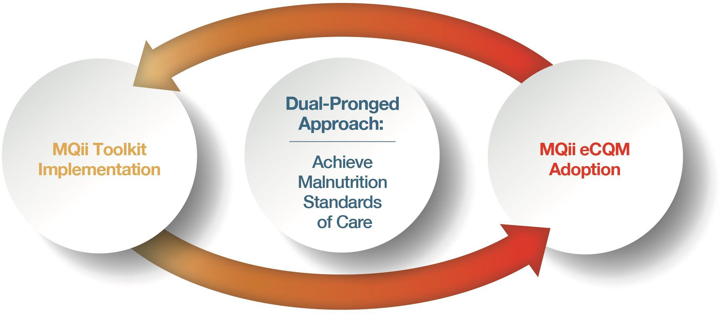
The MQii Provides a Dual-Pronged Approach to
Achieve Malnutrition Standards of Care
The MQii Toolkit provides practical resources to enable hospitals to achieve optimal nutrition standards of care
Data reported from eCQMs will help hospitals demonstrate their success in meeting optimal malnutrition standards of care
Both tools are available for public use free of charge at: http://www.MQii.Today

Slide 12
The Toolkit Offers Start-to-Finish Guidance for Your
Entire Interdisciplinary Care Team
USE OF THE TOOLKIT WILL HELP YOU IDENTIFY AND ADDRESS OPPORTUNITIES FOR
QUALITY IMPROVEMENT
Toolkit Components:
Includes implementation resources:
The Importance of Malnutrition Care
Soliciting leadership buy-in
Identifying a quality improvement project based on your hospital’s existing care practices
Understanding best practices for optimal malnutrition care
Using tools to support education and training
Tracking changes in care with data management information
Assess Your Readiness
Identify Malnutrition QI Opportunities
Access the Toolkit
Training Materials
Clinical Workflow
Best Practice Recommendations
Data Collection Tools
Appendix: Principles and Models
of Quality Improvement
May potentially improve patient and economic outcomes of interest, such as readmissions and length of stay

Slide 13
MQii Tools Reflect Best Practices across the Malnutrition Care Continuum
MQii TOOLKIT AND eCQMs SPAN THE MALNUTRITION CARE WORKFLOW
Screening Nutrition screening using a validated tool for all patients with a hospital admission | Assessment Nutrition assessment using a standardized tool for all patients identified as at- risk for malnutrition | Diagnosis Documentation of nutrition diagnosis for all patients identified as malnourished | Care Plan Development Establishment of a nutrition care plan for all patients identified as malnourished or at-risk for malnutrition
Intervention Implementation*
Implementation of a nutrition care plan including treatment for all patients identified as malnourished or at-risk for malnutrition
Monitoring / Evaluation & Discharge Planning*
Implementation of processes, including discharge planning, that support ongoing monitoring and support the care of patients identified as malnourished or at-risk for malnutrition
Clinician Typically Responsible for Each Step
Nurse | Dietitian | Physician Dietitian | Physician Dietitian Nurse | Physician Dietitian Nurse | Physician Dietitian Nurse
= Measure developed to address this step in the malnutrition care workflow
*Measures for monitoring and evaluation, and discharge planning were not technically feasible due to limitations in availability of measure data.
13

Slide 14
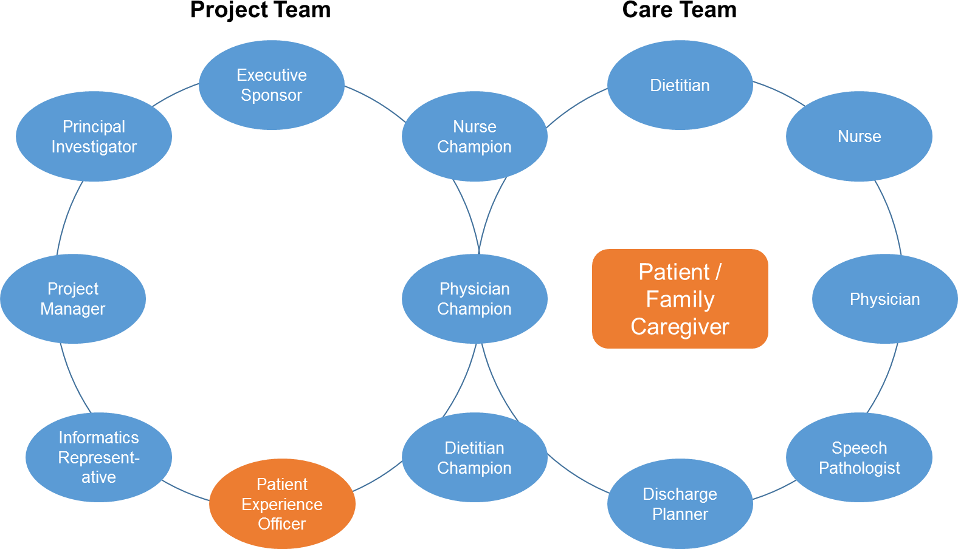
MQii Supports Establishment of Interdisciplinary
Teams to Address Malnutrition Care Gaps
AN INTERDISCIPLINARY TEAM, WITH PARTICIPATION BY PHYSICIANS, NURSES, AND DIETITIANS, IS VITAL TO HOSPITAL-BASED MALNUTRITION QUALITY IMPROVEMENT

Slide 15
Both Components of the Initiative are Grounded
in Multi-Stakeholder Support
Advisory
Committee
Toolkit design and implementation informed by representatives from:
Technical Expert Panel
Measure development informed by representatives from:
Clinical Professional Societies; RDs
Patient Advocacy Organizations
Hospitals and Health Systems
EHRA Quality Measurement Workgroup
Informatics Organizations
Joint Commission
Clinical Professional Societies; RN, RD, MD
Patient organizations
Hospitals
Industry
MQii Toolkit Development
MQii eCQM Development
CMS
Approach informed by regular communication with CMS to ensure alignment with CMS quality goals and adoption of best practices for a quality improvement demonstration

Slide 16
The MQii Learning Collaborative: Toolkit and eCQM Testing and Implementation

Slide 17
Early Testing Results for the eCQMs and the Toolkit Were Positive
In 2016, a small MQii Learning Collaborative tested the eCQMs and Toolkit to assess their ability to be used in the clinical setting and their impact on care delivery; results demonstrated that there is wide variation in standard practices of malnutrition care, but targeted quality improvement efforts can affect change
eCQM Field Testing Results |  |  |  | MQii Toolkit Testing Results
Measure Tested | Hospital 1 | Hospital 2 |  | Hospital 3
 | Performance Results (numerator/denominator and %-score) |  |  | Primary Outcome | Results
Screening (eCQM #1) | 1949/2756 (70.7%) | 1218/1713 (71.1%) |  | Malnutrition knowledge in a multi-disciplinary care team following the Toolkit demonstration | 14% increase from baseline
Assessment (eCQM #2) | 98/346 (28.3%) | 55/114 (48.3%)
Care Plan (eCQM #3) | 27/32** (84.4%) | 183/186 (98.4%) |  | Provider medical diagnosis of malnutrition when there was a dietitian diagnosis of malnutrition | 11.5% increase from baseline
Diagnosis (eCQM #4) | 18/32** (56.3%) | 55/186 (29.6%)
Exploratory analysis of malnutrition quality improvement projects’ impacts on length-of- stay and 30-day readmissions also showed positive results
**Measure calculation is based off of a chart abstracted sample and not representative of the entire hospital's performance; the data required for full electronic report was not available in the format necessary to report a hospital-wide performance rate.
17

Slide 18
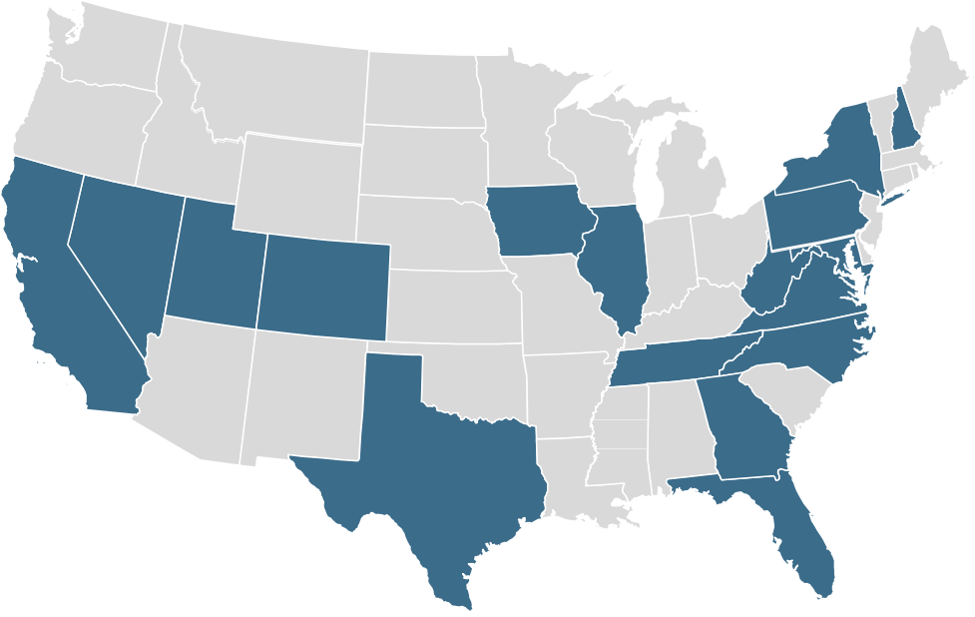
Nationwide Learning Collaborative Supports Expanded Use of MQii Toolkit and eCQMs
The MQii Learning Collaborative intends to implement MQii tools under real-world circumstances to generate evidence on malnutrition care best practices and encourage optimal malnutrition care across the U.S.
In 2016, 6 hospitals participated in the MQii Learning Collaborative
In 2017, 50 hospitals participated in the MQii Learning Collaborative
Distribution of Participating Sites
Participant Demographics
Facility Type:
Short-term Acute Care: 64%
Academic Medical Center: 27%
Other: 9%
Size:
Large: 45%
Medium: 33%
Small: 22%
Geographic Distribution:
Urban: 87%
Rural: 13%
EHR Platforms:
Epic: 67%
Cerner: 27%
Other (AllScripts, Meditech, etc.): 6%

Slide 19
Testimony from Participating Learning Collaborative Sites
“Everyone had the philosophy that the MQii was best for the patient, and was interested in being involved in a project that affected a large percentage of our population. Each discipline brought a unique perspective to the table.”
“By working with members throughout the care team, we are becoming more aware of gaps in communication and are working towards our goal of identifying malnourished patients.”
“The MQii definitely opened the door to resources needed to help collect data as well as put improvement plans in place, whether it be with IT, nursing, medical staff, etc.”
“It’s just the right thing to do, for your staff, your organization and most importantly your patients and community.”

Slide 20
MQii Continues to Expand to More Hospitals
The extension of the Learning Collaborative to a greater number of hospitals will continue to elevate malnutrition and disseminate use of the dual-pronged approach on a national scale
2018 and Beyond
Extended Learning Collaborative
2015
2016
2017
eCQMs
3 Hospitals
3 EHR vendors
Learning Collaborative 6 Hospitals
Learning Collaborative 2.0
50 Hospitals
Malnutrition eCQMs
Malnutrition Toolkit
Malnutrition eCQMs
Malnutrition Toolkit
Dissemination of Tools to Leading Hospitals and Health Systems Nationwide

Slide 21
Opportunities to Engage in the MQii
If you are interested in learning more about the initiative or participating in the MQii Learning Collaborative, please contact the MQii team at malnutritionquality@avalere.com
Note: There are no fees to participate in the Learning Collaborative, and all materials will be provided free of charge
To learn more about the MQii Toolkit and eCQMs, visit www.MQii.today

